Slide 1

HR ANALYSIS DASHBOARD PROJECT

Slide 2
Team Members
01
04
Omar Eissa Ibrahim
Rawda Raafat Ramadan
02
05
Omar Mahmoud Kamel
Maryam Ahmed Salah El-Din
03
06
Diana Adel
Habiba Ragab Mohamed

Slide 3
PROJECT OVERVIEW
This project analyzes Human Resources Data to Uncover workforce patterns and generate meaningful insights. It focuses on key areas such as Employee Demographics, hiring trends, department distribution, and attrition rates to better understand organizational dynamics.
The analysis Helps Identify Factors that impact employee retention and workforce Planning. The Final Outcome Is an Interactive Dashboard That Presents These Insights in a clear and Visual Way, Enabling Stakeholders to make more Informed, Data-driven HR decisions.

Slide 4
DATA SOURCE
Digital Egypt Pioneers Initiative (DIPE)
(Excel, csv)

Slide 5
Question To Be Answer
What is the demographic profile of the workforce (Age, Gender, and Department distribution)?
How is the geographic distribution and commute distance impacting the employees?
What are the key drivers of employee attrition (Overtime, Salary ranges, and Departments)?
How are compensation and stock options distributed across different job roles?

Slide 6
ANALYSIS STEPS
02
04
06
Data Modelling
Reports
Visual Sample
01
03
05
07
Dashboard
Insights
Data
Cleaning
DAX

Slide 7
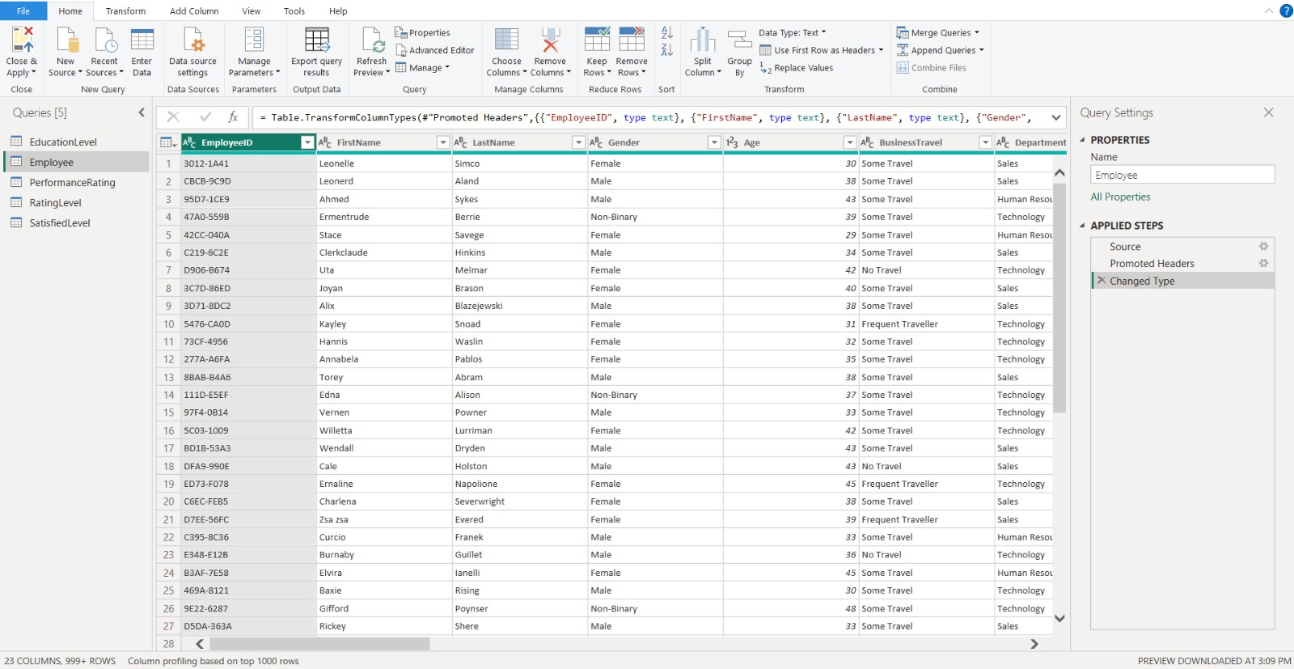
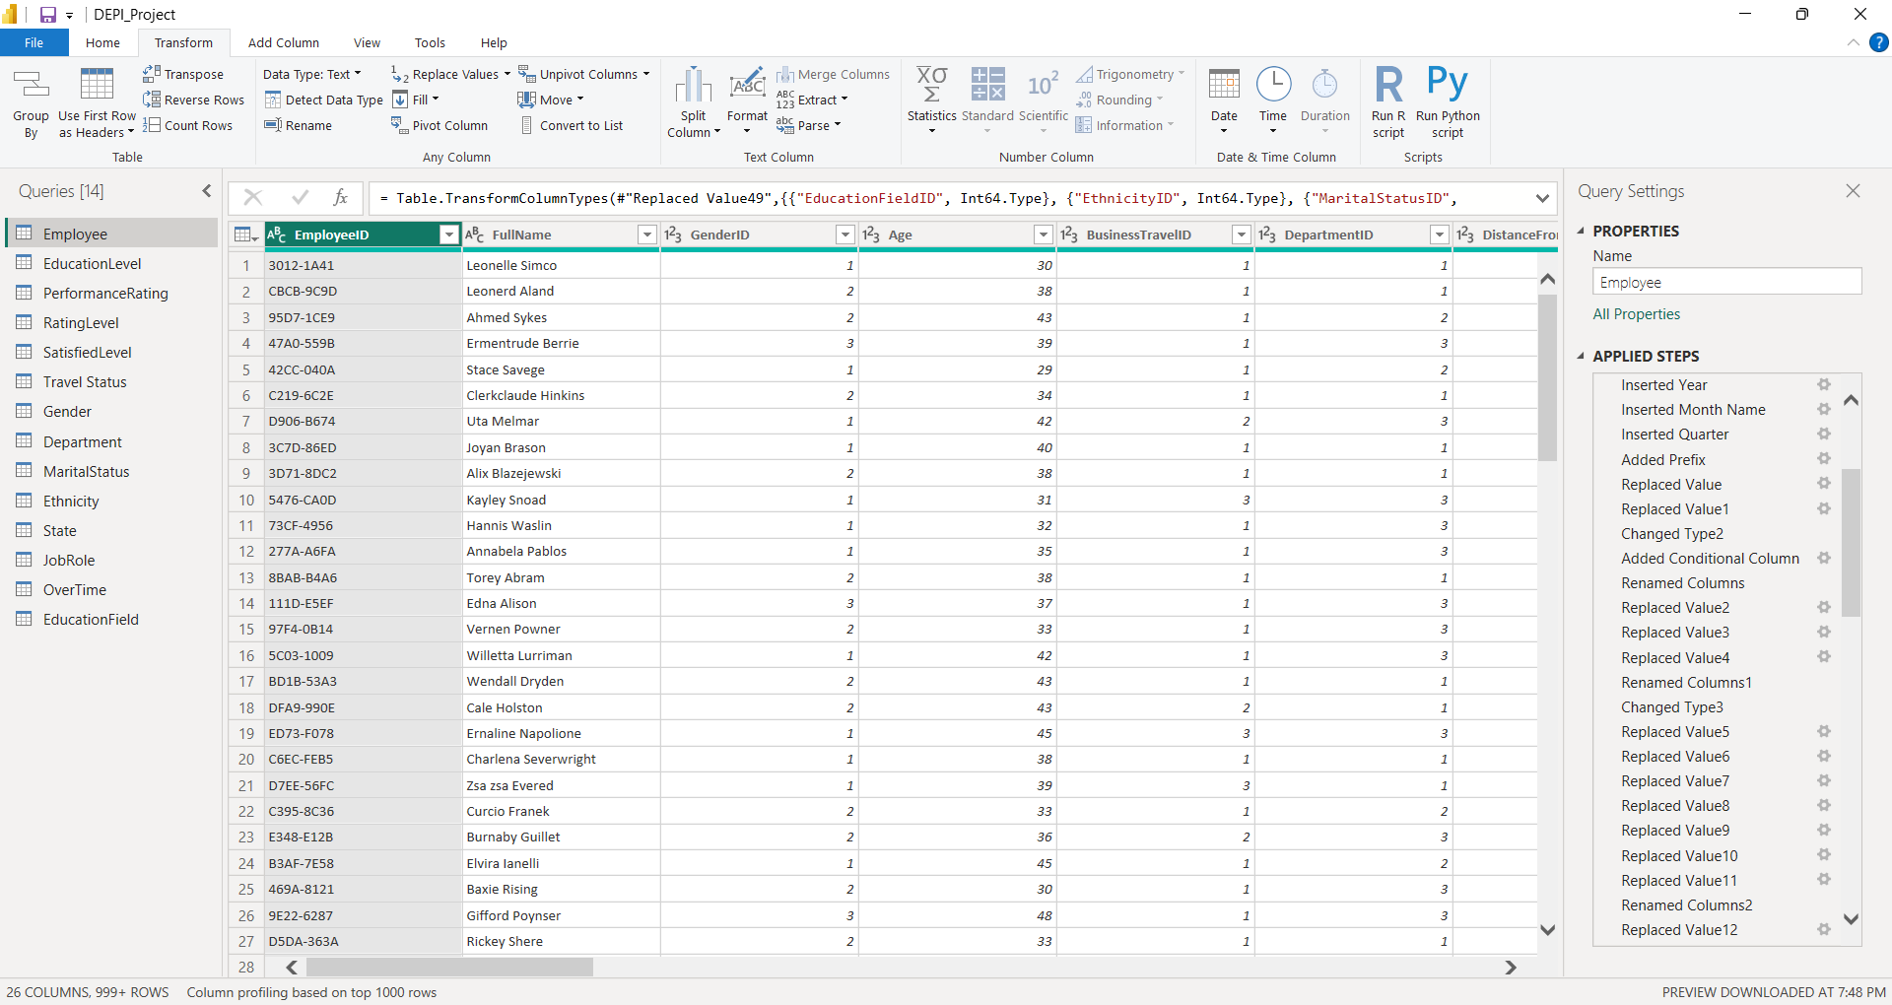
Data Cleaning
01

Slide 8
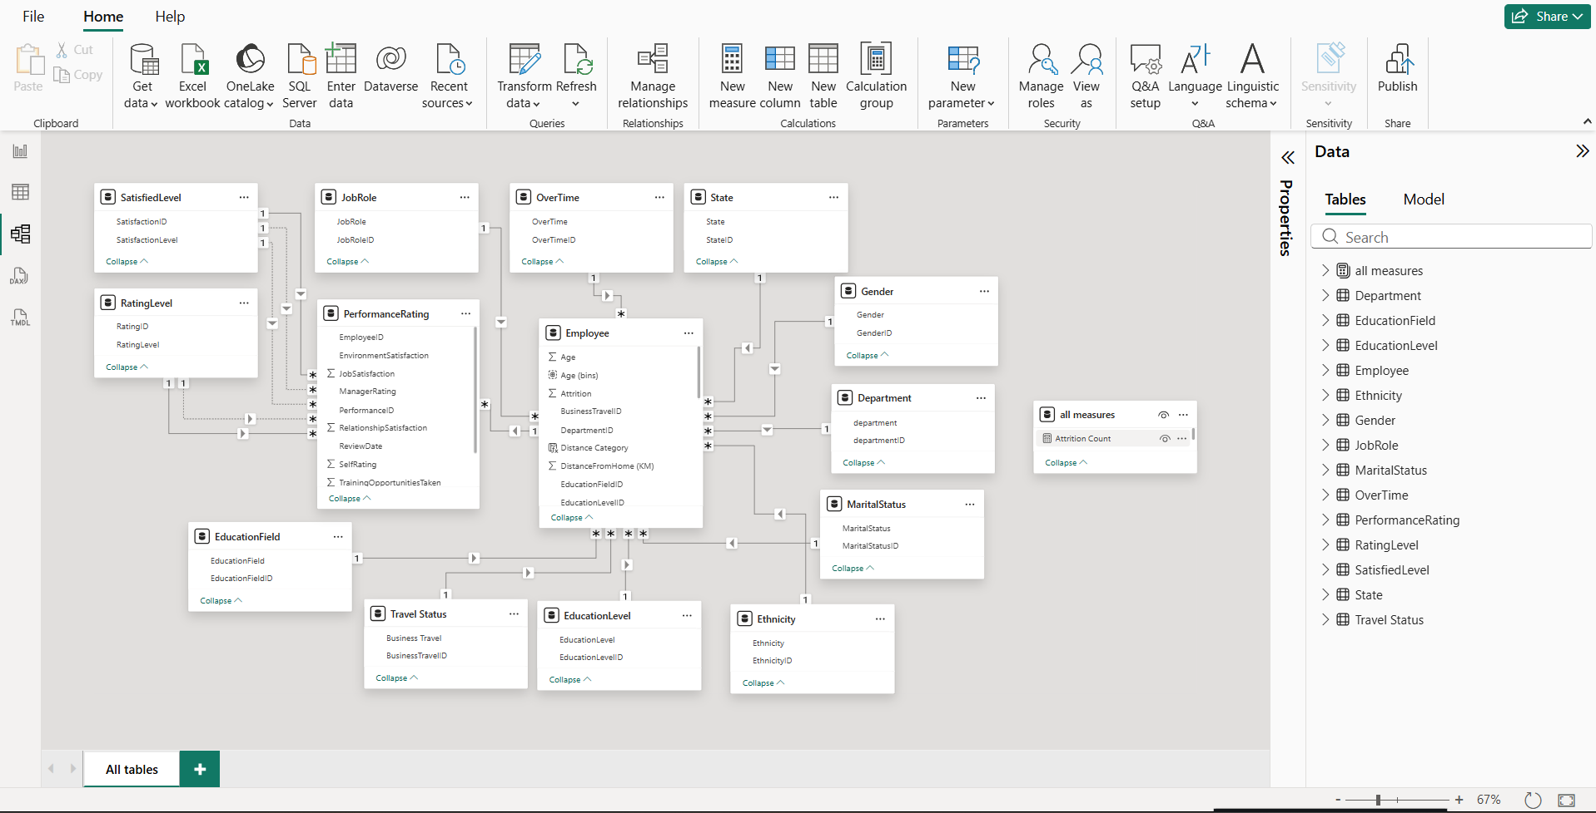
Data Modelling
02

Slide 9
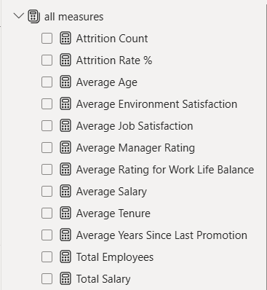
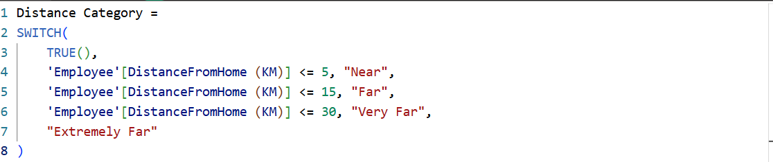
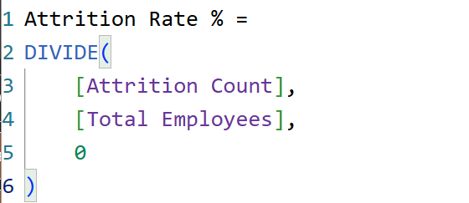
Dax
03
.

Slide 10
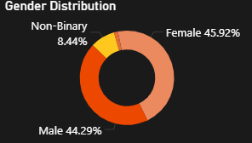
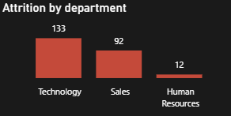
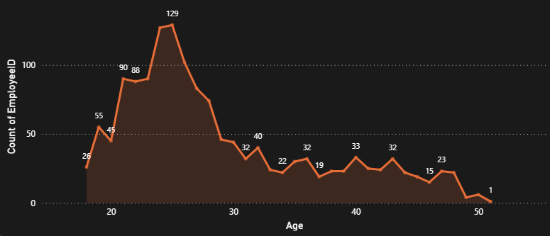
Visual Sample
04
Pie Charts
Used to show the percentage of each part of the total data quickly and easily.
Column Chart
Used to compare different values and quantities
clearly and easily.
Area Graph
Used to show data trends over time while highlighting the total volume of the area.

Slide 11
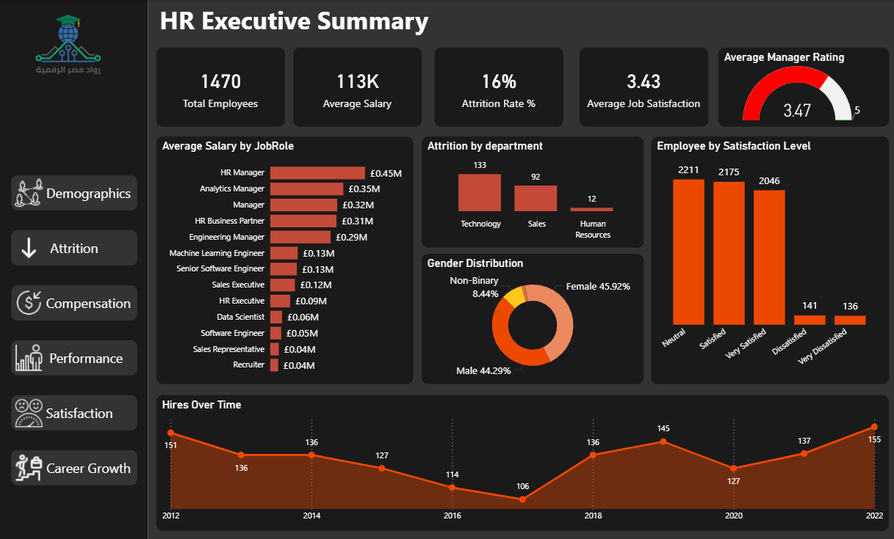
HR Executive Summary Dashboard
05

Slide 12
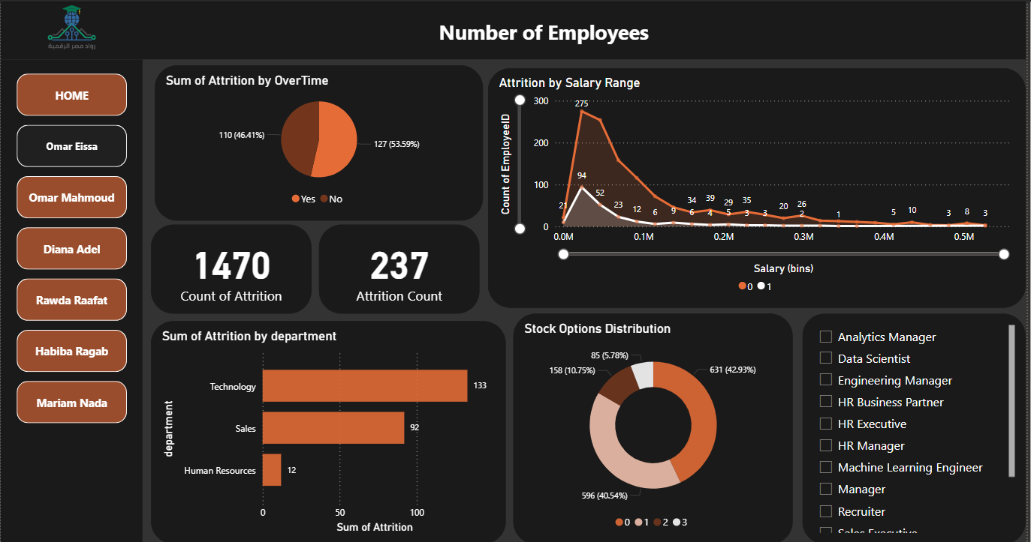
Reports
06

Slide 13
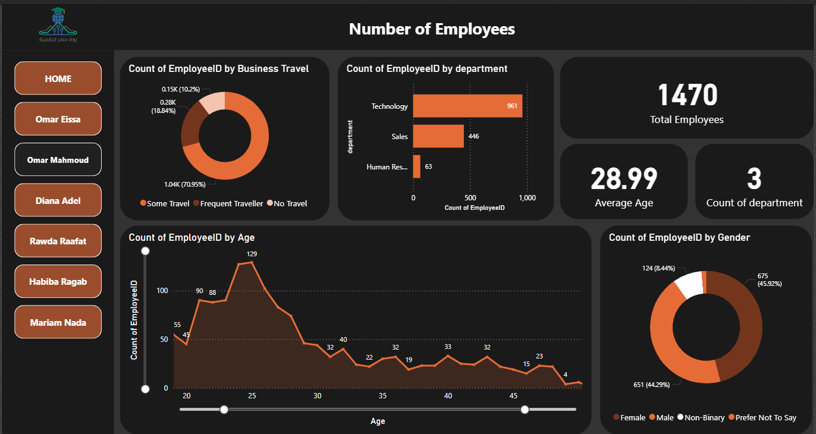
Reports
06

Slide 14
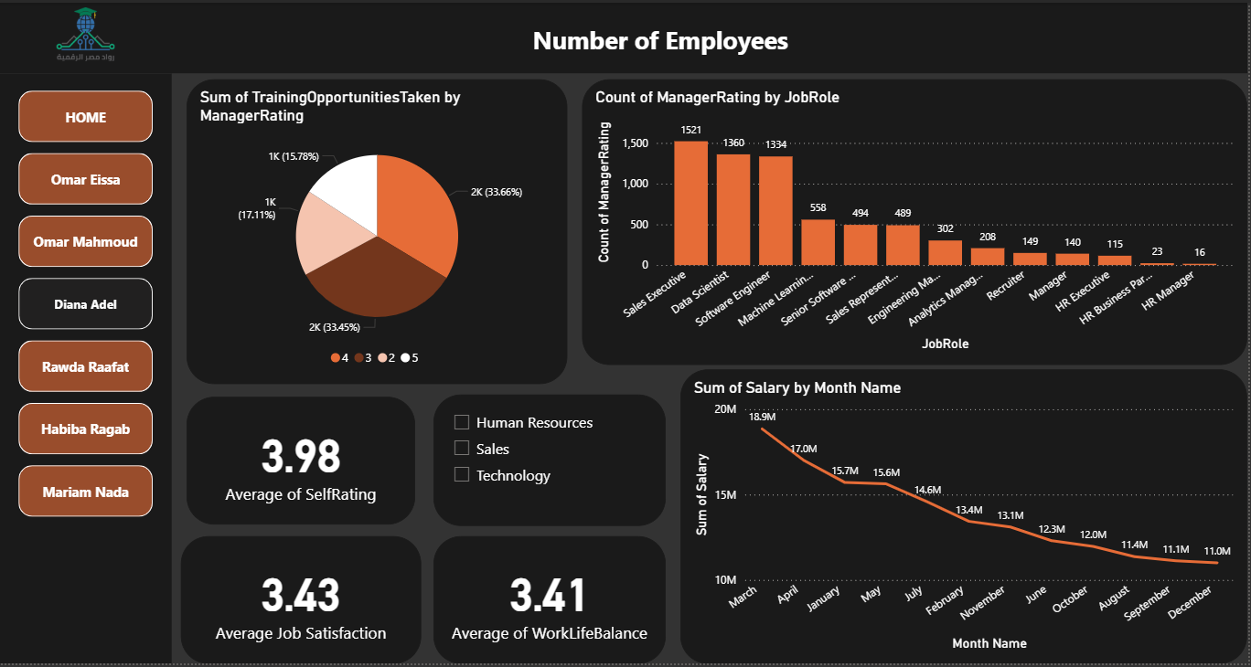
Reports
06

Slide 15
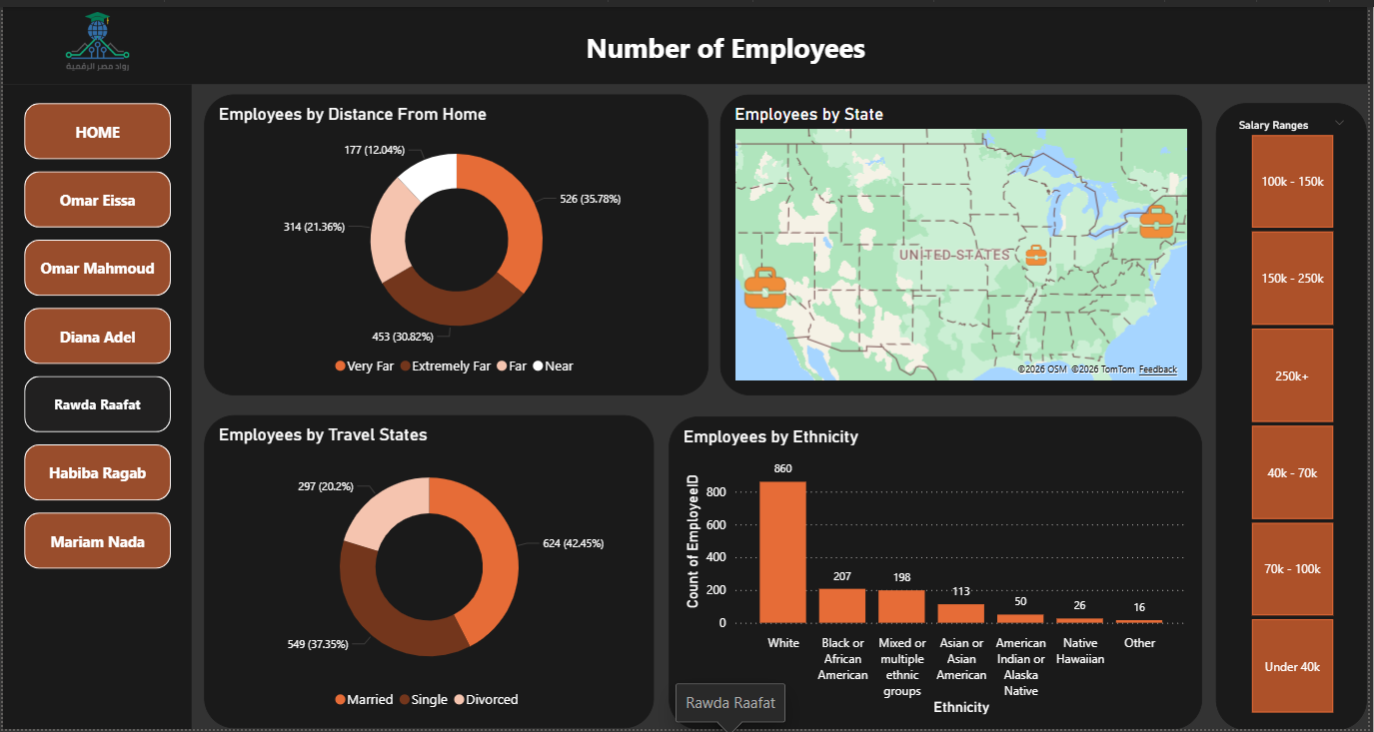
Reports
06

Slide 16
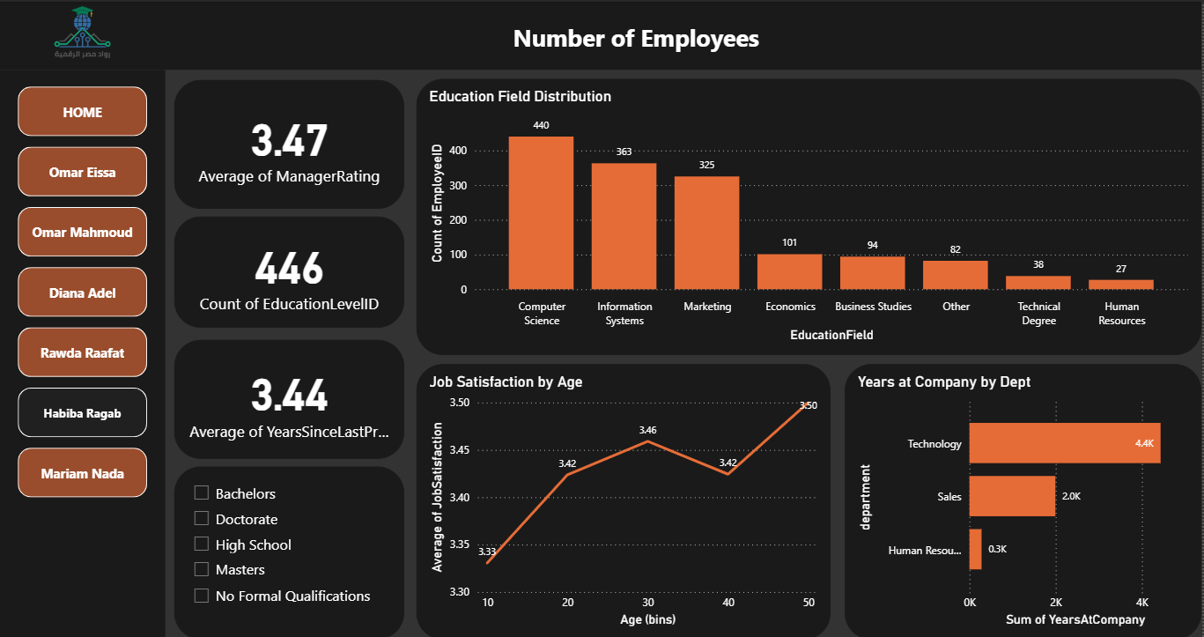
Reports
06

Slide 17
Insights
07
Focus Area | Key Observation | Business Impact | Strategic Recommendation
Retention | Attrition is 30% higher for employees with long commutes (>20km) and high overtime. | Increased recruitment costs and loss of institutional knowledge. | Introduce Hybrid Work options for high-commute roles to reduce burnout.
Growth | High turnover spike observed after 3 years without promotion, even for top performers. | Loss of high-potential talent to competitors due to perceived stagnation. | Implement "Stay Interviews" and clear internal mobility paths at the 2-year mark.
Alignment | Tech Dept shows a 0.6 gap between Self-Ratings (3.8) and Manager Ratings (3.2). | Risk of workplace conflict and decreased job satisfaction. | Standardize Performance Rubrics to align expectations across departments.
Development | Staff with 3+ training sessions show 15% higher ratings and better Work-Life Balance. | Direct correlation between continuous learning and operational efficiency. | Mandate Learning Hours as a core KPI for Department Managers.

Slide 18

Thank You
GitHub

